Slide 1
GenAI and LLM

Slide 2

WHO AM I?
LinkedIn: https://www.linkedin.com/in/latha-t-k-b21018128/
Data Science ,AIML
Data Analysis ,SQL, Pyspark
Data Visualization ,PowerBI, Tableau
Natural Language Processing (NLP)
Computer Vision
Generative AI,Prompt Engineering
BigData and Data Engineering

Slide 3


Slide 4


Slide 5


Slide 6
What is Data?

Slide 7
What is DATA?
Data is a collection of facts, figures, observations, or measurements that can be analyzed to gain insights.
It can be structured (like tables in a database) or unstructured (like text, images, or videos).
Data is crucial for decision-making in businesses, research, and technology.

Slide 8
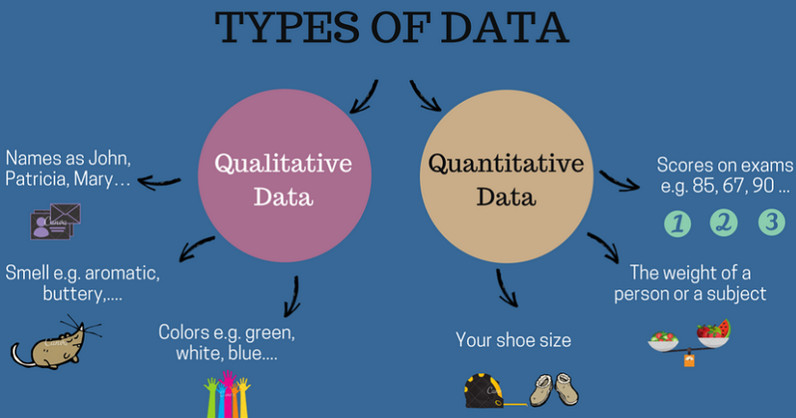

Slide 9
Part 1: Identifying Types of Data
Categorize each example as Qualitative (Categorical) or Quantitative (Numerical).
Customer satisfaction rating (Happy, Neutral, Sad)
Number of employees in a company
Price of a laptop (in ₹)
Name of a bank
Loan status (Approved/Rejected)
Annual revenue of a company

Slide 10
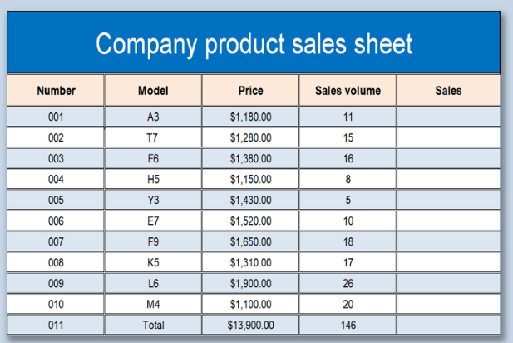
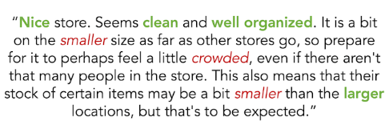

Slide 11
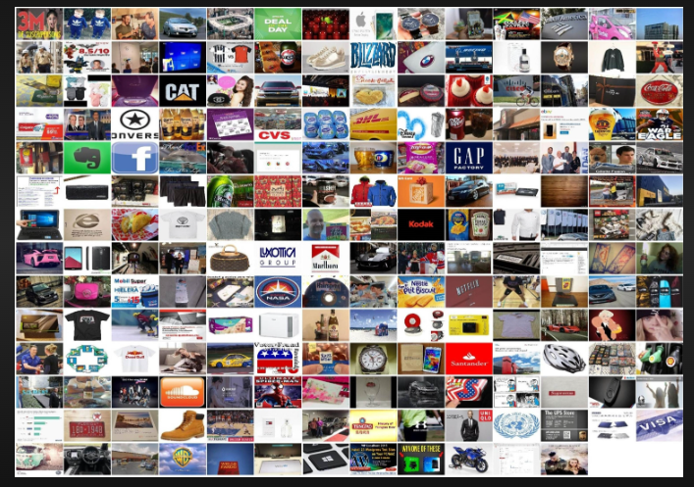
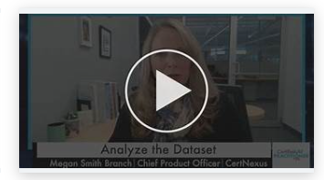
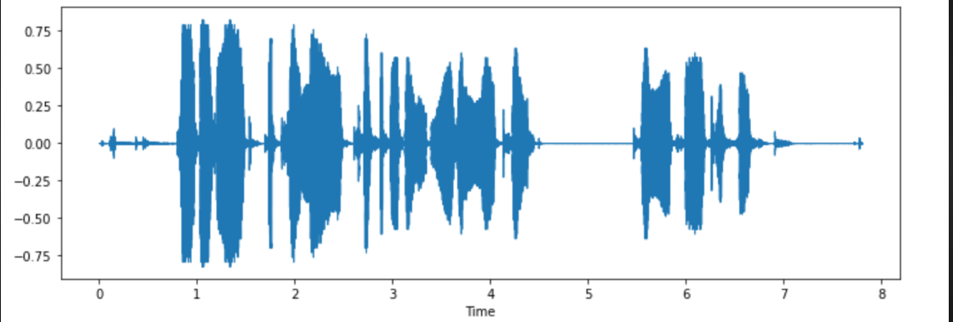

Slide 12
Structured or Unstructured?
Customer purchase history in a database
Video recordings of stock market news
Excel sheet with employee salary data
WhatsApp chat messages
Weather sensor readings

Slide 13
When to Use ML, CV, NLP, and DL?
Each technique—Machine Learning (ML), Computer Vision (CV), Natural Language Processing (NLP), and Deep Learning (DL)—is used based on the type of data and the problem being solved.

Slide 14
Machine Learning (ML)
Use ML when:
You have structured/tabular data (e.g., sales records, customer transactions).
You need to make predictions, classifications, or clustering.
Examples:
Predicting loan approvals (Classification)
Customer churn prediction
Fraud detection in banking
Recommender systems (Netflix, Amazon)

Slide 15
Computer Vision (CV)
Use CV when:
You are working with images or videos.
You need to analyze, classify, or generate images.
Examples:
Face recognition in security systems
Object detection in self-driving cars
Medical image analysis (e.g., detecting tumors in MRI scans)
Defect detection in manufacturing

Slide 16
Natural Language Processing (NLP)
Use NLP when:
You are working with text or speech data.
You need to understand, generate, or translate language.
Examples:
Chatbots and virtual assistants (Siri, Alexa)
Sentiment analysis of customer reviews
Machine translation (e.g., Google Translate)
Email spam detection

Slide 17
Deep Learning (DL)
Use DL when:
Your dataset is large and complex (images, speech, unstructured text).
Traditional ML models do not perform well.
You need high accuracy and have computational power (GPUs/TPUs).
Examples:
Autonomous driving (Self-driving cars)
Image generation (Deepfake technology)
Speech recognition (Google Assistant, Alexa)
Large Language Models (ChatGPT, Gemini,COPILOT)

Slide 18
Problem Statements
A bank wants to predict whether a customer will default on a loan based on transaction history and demographics.
A company wants to classify customer support emails as complaints, inquiries, or feedback.
A factory needs an AI system to detect defects in manufactured products by analyzing images.

Slide 19
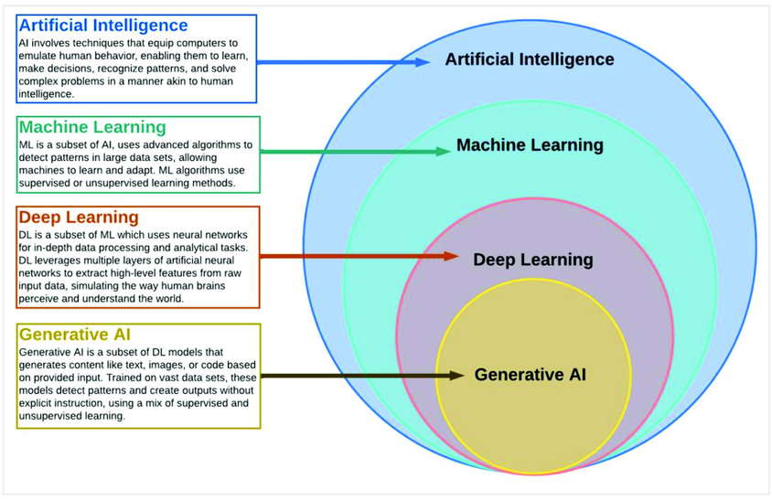

Slide 20
Types of Analytics
In today's data-driven world, information is king. But raw data itself isn't enough.
We need to analyze it to extract insights and make informed decisions

Slide 21






Slide 22
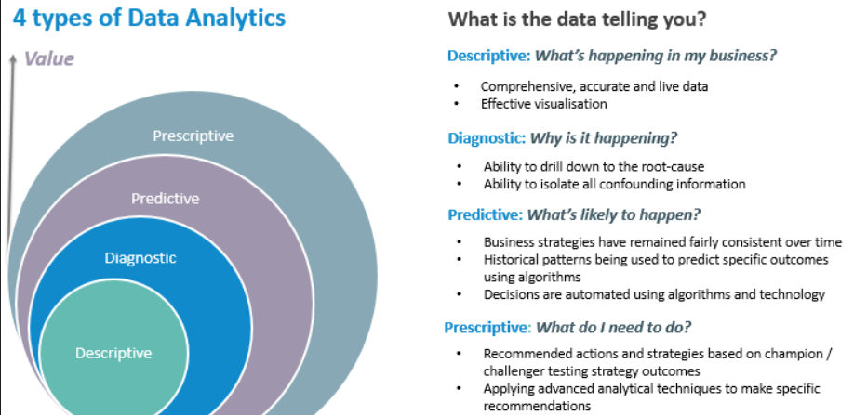

Slide 23
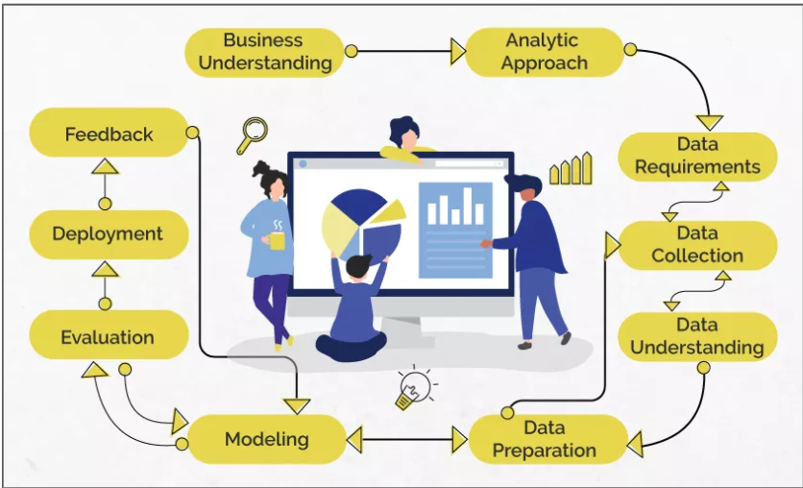
Data Science/Machine Learning

Slide 24
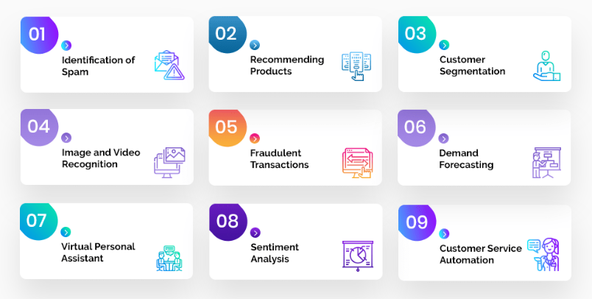
Problem Statement

Slide 25
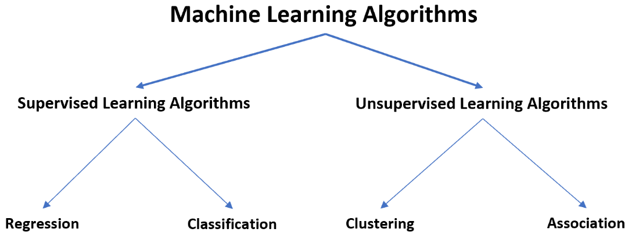

Slide 26
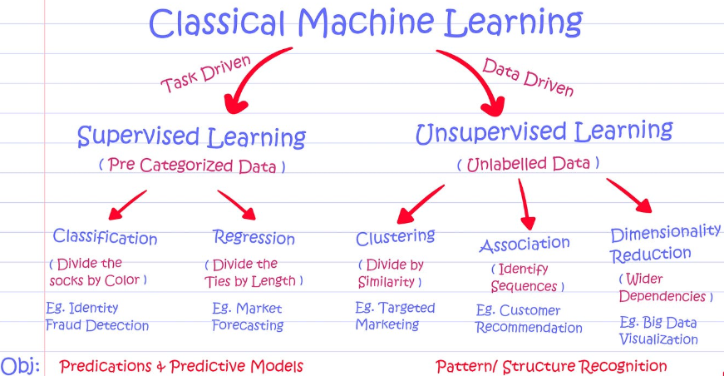

Slide 27
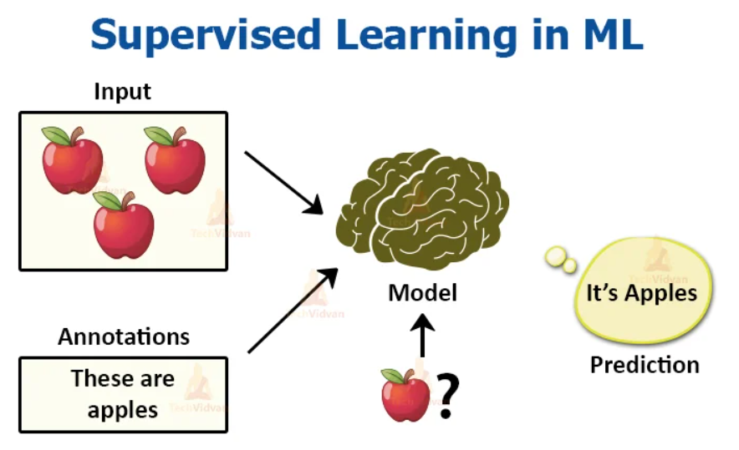

Slide 28
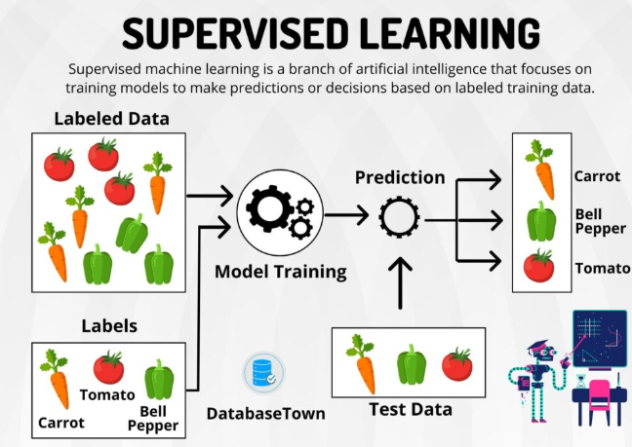

Slide 29
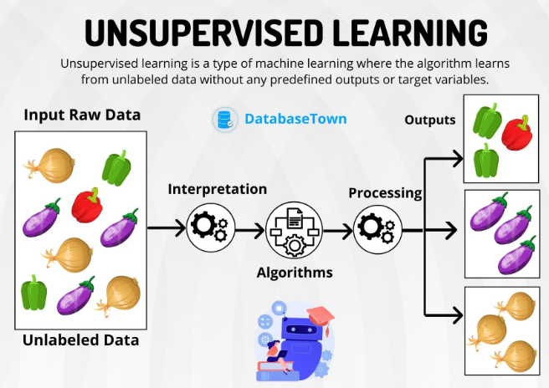

Slide 30
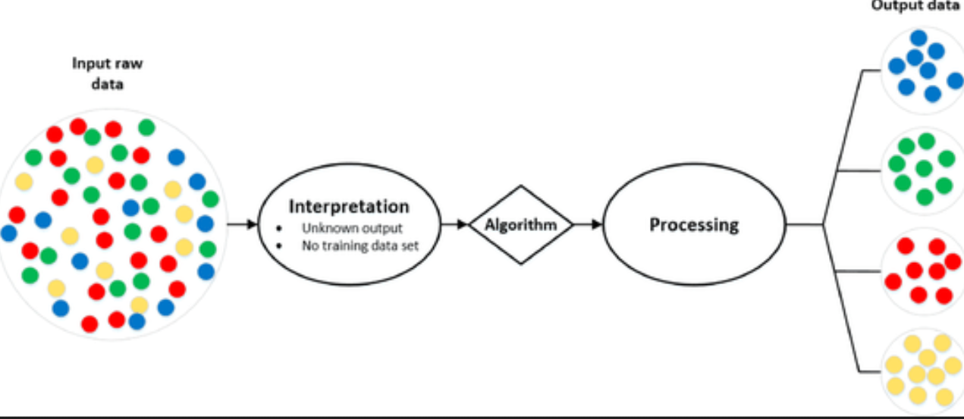
Analytic Approach

Slide 31
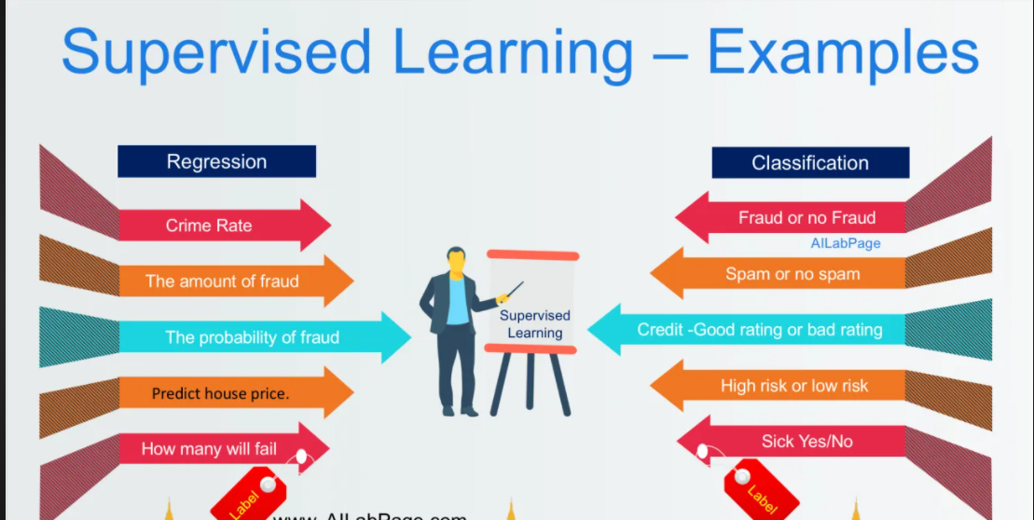
Supervised Learning

Slide 32
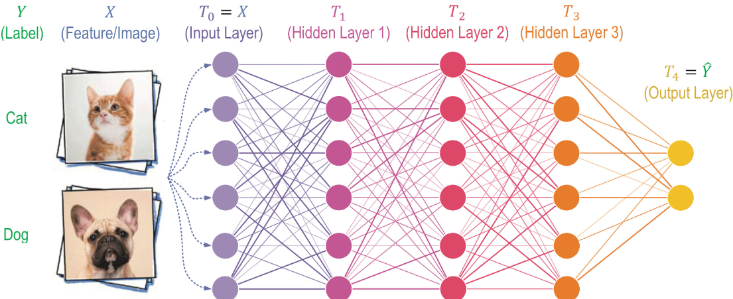

Slide 33
Microsoft OpenAI – Enterprise, Secure, Private, and Responsible AI
Enterprise Integration
Access OpenAI's advanced models like GPT-4 and DALL·E within Azure
Enhance applications with AI-powered language and content generation
Security and Privacy
Data remains private and exclusive to the organization
Compliance with industry regulations and enterprise security standards
Responsible AI Practices
Guided by Microsoft's Responsible AI Standard for fairness and transparency
Built-in tools for content moderation and ethical AI deployment

Slide 34
Chat Models Vs Reasoning Models
Chat Models
Designed for natural language conversations
Focus on contextual responses and engagement
Examples: GPT-based chatbots, virtual assistants
Strengths: Human-like interaction, text generation

Slide 35
Chat Models Vs Reasoning Models
Reasoning Models
Built for logical inference and decision-making
Focus on solving complex problems with structured reasoning
Examples: Symbolic AI, knowledge-based systems
Strengths: Better accuracy in problem-solving, structured outputs

Slide 36


Slide 37


Slide 38


Slide 39
What is Prompt Engineering?
The practice of designing and refining prompts to optimize AI-generated responses.
Helps in guiding AI models like GPT-4 to produce relevant, accurate, and high-quality outputs.
Involves techniques like using clear instructions, providing context, and specifying output formats.
Used in applications such as chatbots, content generation, and decision-making systems.

Slide 40
Methods of Prompt Engineering
Zero-shot Prompting
Directly asking the model a question without examples.
Explain machine learning in simple terms.
What are the key factors affecting stock market prices?

Slide 41
Methods of Prompt Engineering
One-shot Prompting
Providing a single example to guide the AI’s response.
Example: “Translate ‘Hello’ to French: Bonjour. Now translate ‘Goodbye’.”

Slide 42
Methods of Prompt Engineering
One-shot Prompting:
If a person with a credit score of 750 and an income of $80,000 is approved for a loan, what about a person with a credit score of 680 and an income of $50,000?
Few-shot Prompting
A person with a credit score of 750 and income of $80,000 was approved.
A person with a credit score of 600 and income of $40,000 was denied.
A person with a credit score of 720 and income of $70,000 was approved.
Now, predict the loan decision for a person with a credit score of 680 and an income of $50,000."*

Slide 43
Methods of Prompt Engineering
Chain-of-Thought (CoT) Prompting
Encouraging step-by-step reasoning for complex problems.
Example: “Solve 24 × 3 + 12. First, multiply 24 by 3, then add 12.”
An investor is considering buying stocks in Company A. The company's revenue is growing at 10% per year, and it has a P/E ratio of 25. Interest rates are expected to rise next year. Should the investor buy the stock? Explain step by step.

Slide 44
Methods of Prompt Engineering
Role-based Prompting
Assigning a specific role to the AI for better responses.
Example: “You are a customer support agent. Answer the query professionally.”
You are a seasoned financial advisor. A client wants to invest ₹10 lakhs and is looking for low-risk options. Provide a step-by-step investment strategy.

Slide 45
Methods of Prompt Engineering
Persona-based Prompting
Making the AI respond in a particular style or tone.
Example: “Explain quantum physics as if you were a 5-year-old.”
You are the CFO of a multinational company. Your board is considering expanding into India. Analyze the financial risks and opportunities.

Slide 46
Methods of Prompt Engineering
Refinement and Iterative Prompting
Adjusting prompts based on initial responses for better results.
Example: If the response is too vague, rephrase with more details.

Slide 47
Microsoft method of Prompt Engineering
1. Grounding with Enterprise Data
Enhancing AI responses by integrating company-specific data sources.
Ensures AI-generated content is relevant and fact-based.
2. Retrieval-Augmented Generation (RAG)
AI fetches external information before responding.
Improves accuracy and reduces hallucinations.

Slide 48
Microsoft method of Prompt Engineering
3. Few-shot and Chain-of-Thought Prompting
Uses structured examples and logical reasoning to refine responses.
Helps in better problem-solving and decision-making.
4. Guardrails for Responsible AI
Implementing ethical guidelines to ensure safe and unbiased outputs.
Content filtering, bias detection, and compliance checks.

Slide 49
Microsoft method of Prompt Engineering
5. Adaptive Prompts for Context Awareness
Dynamically adjusting prompts based on conversation history.
Maintains continuity in long-form interactions.

Slide 50
Give Direction and Specify Prompts
1. Be Clear and Specific
Clearly define the task to get precise responses.
Example: “Summarize this article in three bullet points.”
📌 2. Set a Role or Persona
Assign a role for better context.
Example: “You are a business analyst. Explain the latest market trends.”

Slide 51
Give Direction and Specify Prompts
3. Define the Output Format
Specify how the response should be structured.
Example: “List the pros and cons in a table format.”
📌 4. Use Step-by-Step Instructions
Guide the AI through logical reasoning.
Example: “First, explain machine learning, then give an example.”

Slide 52
Give Direction and Specify Prompts
5. Limit or Expand the Scope
Control the level of detail in responses.
Example: “Explain AI in one sentence” vs. “Provide a detailed explanation.”

Slide 53
Provide Examples and Evaluate Quality
1. Provide Clear Examples
Use relevant examples to guide AI responses.
Example: "Translate ‘Hello’ to French: Bonjour. Now translate ‘Goodbye’."
📌 2. Test with Multiple Variations
Try different phrasings to check AI consistency.
Example: Asking “What is AI?” vs. “Explain AI like I’m 5.”

Slide 54
Provide Examples and Evaluate Quality
3. Evaluate Response Accuracy
Check if the response is factual and relevant.
Look for correctness, clarity, and alignment with the prompt.
4. Measure Coherence and Completeness
Ensure the response flows logically and is well-structured.
Example: Does the AI provide all necessary details?

Slide 55
Provide Examples and Evaluate Quality
5. Refine and Iterate
Adjust the prompt to improve quality.
Example: If the response is vague, add more details to the prompt.

Slide 56
List Generation & Sentiment Analysis
List Generation
AI can generate structured lists for tasks, recommendations, or insights.
Examples:
“Generate a list of 10 trending AI tools with a brief description.”
“List 5 strategies to improve customer engagement.”
“Provide 7 key factors for evaluating loan eligibility.”
“Generate a to-do list for launching a new marketing campaign.”

Slide 57
Sentiment Analysis
AI analyzes text to determine sentiment (Positive, Negative, Neutral).
Examples:
“Analyze sentiment in this customer review: ‘Excellent service, but the response time was slow.’”
“Determine the sentiment of this tweet: ‘Love the new product features!’”
“Classify the sentiment of this email from a customer regarding delayed payments.”
“Identify whether this online comment is positive, negative, or neutral.”

Slide 58
Writing Clear Instructions
1. Use Details & Specificity
Clearly define what you need for financial analysis.
Examples:
“Summarize the key financial trends for 2024 in 3 bullet points.”
“Generate 5 investment strategies for high-risk investors.”
“Provide a step-by-step guide for applying for a personal loan.

Slide 59
Writing Clear Instructions
2. Use Delimiters
Use clear markers (quotes, brackets) to define specific input areas.
Examples:
“Extract key insights from the financial report between [Revenue] and [Expenses].”
“Rewrite the content inside ‘quotation marks’ in a more concise financial summary.”
“Analyze sentiment only for the section labeled [Customer Loan Feedback].”

Slide 60
Writing Clear Instructions
3. Specify Length
Set word limits or response size for financial reporting.
Examples:
“Explain inflation in a single sentence.”
“Provide a 100-word summary of the latest RBI policy changes.”
“List 10 factors affecting loan eligibility in under 50 words each.”

Slide 61
Question Rewriting – Finance Use Cases
Reframe for Clarity
Make complex financial questions easier to understand.
Example:
❌ “How does monetary policy impact financial markets?”
✅ “Explain how changes in interest rates affect stock prices and investments.”

Slide 62
Question Rewriting – Finance Use Cases
Adapt for Different Audiences
Rewrite based on the target audience (beginner, expert, investor, etc.).
Example:
For a beginner: “What is a credit score, and why is it important?”
For an expert: “Explain how credit scoring models assess borrower risk.”

Slide 63
Question Rewriting – Finance Use Cases
3. Convert Open-ended to Specific Questions
Make broad finance-related questions more targeted.
Example:
❌ “Tell me about personal finance.”
✅ “What are the top 5 personal finance tips for first-time investors?”

Slide 64
Question Rewriting – Finance Use Cases
4. Make Questions More Data-Driven
Add numerical or timeframe-based elements.
Example:
❌ “How do stock markets perform during a recession?”
✅ “How did the NIFTY 50 index perform during the 2008 financial crisis?”

Slide 65
Give Direction and Specify Prompts
1. Define the Objective Clearly
Clearly state what you want AI to do.
Example:
“Analyze the impact of rising interest rates on home loan affordability.”
“Summarize the key takeaways from the latest RBI monetary policy statement.”

Slide 66
Give Direction and Specify
2. Use Step-by-Step Instructions
Break down complex financial tasks into structured steps.
Example:
“Step 1: Identify the top-performing mutual funds in the last 5 years.
Step 2: Compare their returns with benchmark indices.
Step 3: Suggest investment strategies for risk-averse investors.”

Slide 67
Give Direction and Specify Prompts
3. Provide Context
Give background information for precise responses.
Example:
“Based on India's inflation trends from 2015-2023, predict inflation rates for the next 3 years.”
📌 4. Specify Output Format
Define the structure of the response (tables, bullet points, summaries, etc.).
Example:
“List the top 5 investment options in a table format with columns: Risk Level, Expected Returns, and Investment Horizon.”

Slide 68
Give Direction and Specify Prompts
5. Guide Tone and Detail Level
Control complexity and tone based on the audience.
Example:
“Explain the benefits of SIP in mutual funds in a simple and engaging way for first-time investors.”
“Provide an in-depth financial analysis of the bond market for institutional investors.”

Slide 69
Provide Examples and Evaluate Quality –
1. Give Examples to Guide AI Responses
Providing clear examples improves accuracy.
Example:
Prompt: “Classify the following loan applications as High Risk, Medium Risk, or Low Risk.”
Example Input:
Applicant A: Credit Score 750, Stable Income, No Debt → Low Risk
Applicant B: Credit Score 580, Irregular Income, High Debt → High Risk

Slide 70
Provide Examples and Evaluate Quality –
2. Set Evaluation Criteria
Define what makes a good response.
Example:
“Summarize the financial report in 5 bullet points, each under 20 words.”
Criteria: Should include revenue, profit margin, expenses, growth rate, and key risks.

Slide 71
Provide Examples and Evaluate Quality
3. Compare AI Outputs with Human Expectations
Evaluate whether the response meets financial analysis standards.
Example:
Prompt: “Predict the impact of inflation on fixed deposit interest rates.”
Evaluation: Check if the response considers historical trends, RBI policies, and economic factors.

Slide 72
Provide Examples and Evaluate Quality
4. Iterate and Refine the Prompt
Improve prompt clarity for better results.
Example:
❌ “Explain financial risk.” (Too broad)
✅ “Explain financial risk with examples of credit risk and market risk in banking.”

Slide 73
Meta Prompts
1. What are Meta Prompts?
Meta prompts guide AI to generate better prompts for a specific use case.
Used to improve financial insights, reports, and predictions.
2. Generate Prompts Dynamically
AI can create prompts based on user needs.
Example:
“Suggest a prompt to analyze stock market trends over the last decade.”
“Generate a prompt to evaluate a company's financial health using its balance sheet.”

Slide 74
Meta Prompts
3. Fine-Tune Prompts for Better Accuracy
AI can refine and improve existing financial prompts.
Example:
Input: "What are good investment options?"
Refined Prompt: "List 5 investment options for a risk-averse investor in India, including expected returns and risks."
📌 4. Use AI to Generate Report Structures
Automate financial reporting templates.
Example:
“Create a prompt for an AI assistant to generate a quarterly financial summary with revenue, expenses, and net profit.”

Slide 75
Meta Prompts
5. Optimize Customer Queries in Finance
AI can refine customer queries for better insights.
Example:
Customer Query: "Should I take a loan?"
Optimized Prompt: "Provide a risk assessment for a ₹10 lakh personal loan with a 5-year tenure at 10% interest."

Slide 76
Prompt Optimizing
1. Improve Clarity and Precision
Make financial prompts more specific for better AI responses.
Example:
❌ “Analyze stock market trends.” (Too vague)
✅ “Analyze NIFTY 50 trends from 2010-2023, considering inflation, GDP growth, and global events.”
📌 2. Add Constraints and Filters
Guide AI to focus on relevant financial data.
Example:
“List 5 investment options with returns above 10% and low volatility in the last 5 years.”

Slide 77
Prompt Optimizing
3. Break Down Complex Queries
Split financial prompts into smaller steps for better results.
Example:
Step 1: Identify sectors that outperformed in the last 3 years.
Step 2: List top companies in these sectors with consistent revenue growth.
📌 4. Optimize for Different Use Cases
Adapt prompts based on the audience (investors, analysts, customers).
Example:
For an Investor: “Explain risk and return trade-offs for mutual funds.”
For an Analyst: “Analyze the Sharpe ratio of top mutual funds in India.”

Slide 78
Prompt Optimizing
5. Test and Iterate for Best Results
Experiment with different prompt structures to improve AI responses.
Example:
“Summarize key takeaways from the RBI policy in 100 words.”
Adjust for more details: “Summarize RBI policy impacts on inflation, interest rates, and banking sector in 5 bullet points.”

Slide 79
Prompt Caching
1. What is Prompt Caching?
Storing frequently used prompts to save time and improve efficiency.
Useful for repetitive financial queries and reports.
📌 2. Automate Recurring Financial Analyses
Save and reuse prompts for regular financial tasks.
Example:
“Generate a weekly market summary for the NIFTY 50, covering top gainers, losers, and key news.”

Slide 80
Prompt Caching
3. Optimize Customer Support Queries
Store common queries to enhance financial service automation.
Example:
“What is the current home loan interest rate and eligibility criteria?”
“Explain EMI calculation for a ₹10 lakh loan with a 7% interest rate over 5 years.”
📌 4. Reduce Processing Time for Financial Reports
Predefine prompts to quickly generate investment insights.
Example:
“Fetch and compare quarterly financial performance for top 3 banks in India.”

Slide 81
Prompt Caching
5. Maintain Consistency in Financial Advice
Ensure uniform responses for regulatory compliance.
Example:
“Explain tax-saving investment options under Section 80C with a comparison table.”
📌 6. Create Prompt Templates for Customization
Allow users to modify stored prompts for specific needs.
Example:
“Analyze the financial health of [Company Name] using profitability, liquidity, and solvency ratios.”

Slide 82
Role Prompting
1. What is Role Prompting?
Instructing AI to adopt a specific role for better responses.
Helps generate expert-level insights in financial contexts.
📌 2. Role: Financial Analyst
AI acts as a financial expert providing investment insights.
Example Prompt:
“You are a financial analyst. Evaluate the risk and return profile of mid-cap mutual funds over the last 5 years.”

Slide 83
Role Prompting
3. Role: Investment Advisor
AI offers personalized investment suggestions.
Example Prompt:
“As an investment advisor, suggest a diversified portfolio for a conservative investor with ₹10 lakh.”
📌 4. Role: Risk Manager
AI assesses financial risks and mitigation strategies.
Example Prompt:
“You are a risk manager. Identify potential risks in the loan approval process and suggest mitigation strategies.”

Slide 84
Role Prompting
5. Role: Tax Consultant
AI provides tax-saving strategies and compliance advice.
Example Prompt:
“As a tax consultant, suggest the best tax-saving investments under the new tax regime.”
📌 6. Role: Fraud Detection Specialist
AI detects suspicious financial activities.
Example Prompt:
“You are a fraud detection expert. Identify red flags in credit card transactions indicating possible fraud.”

Slide 85
Role Prompting
7. Role: Banking Customer Support Agent
AI helps in answering customer queries.
Example Prompt:
“Act as a banking support agent and explain the benefits of a fixed deposit to a first-time customer.”

Slide 86
Prompt Engineering: Use Cases and Real-World Examples
Real-World Use Cases of Prompt Engineering
Financial Decision-Making
Banking & Loan Processing
Fraud Detection in Finance
Customer Support Automation
Tax Planning & Compliance
Market Research & Sentiment Analysis

Slide 87
Prompt Engineering: Use Cases and Real-World Examples
Indian Customers Using Prompt Engineering for Productivity & Efficiency
Retail Banking Customers
Small Business Owners
Stock Market Investors
Loan & Mortgage Seekers
Insurance Buyers
Freelancers & Gig Workers
Students & Professionals

Slide 88
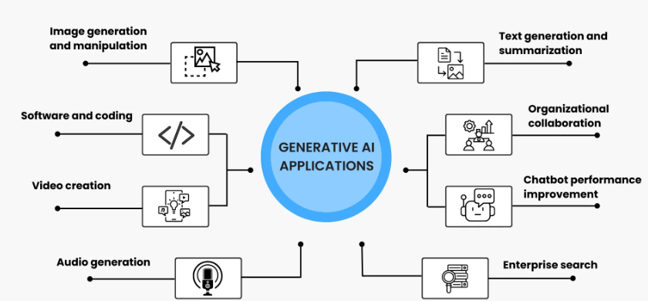

Slide 89
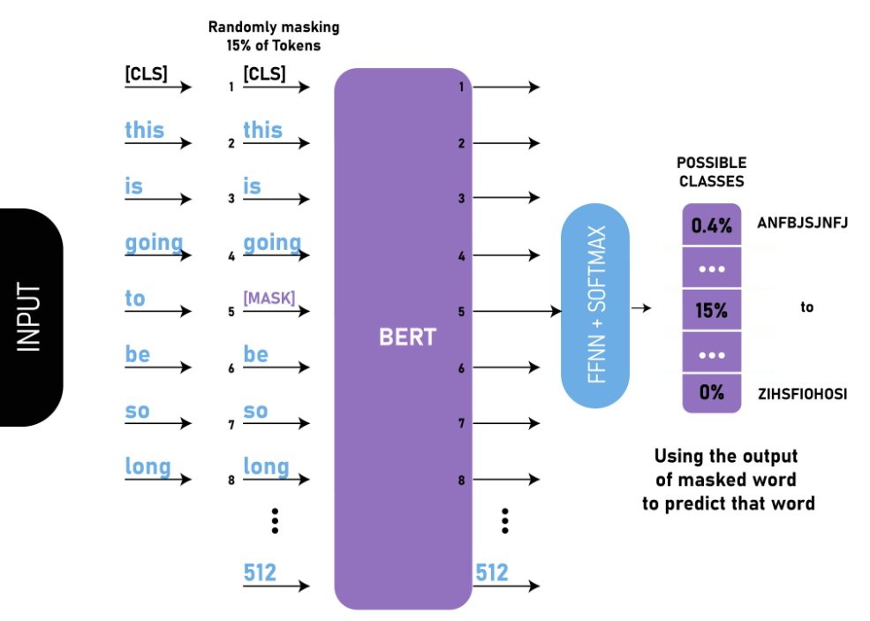

Slide 90
What is a Token? https://platform.openai.com/tokenizer https://azure.microsoft.com/en-us/products/ai-model-catalog#Models

Slide 91
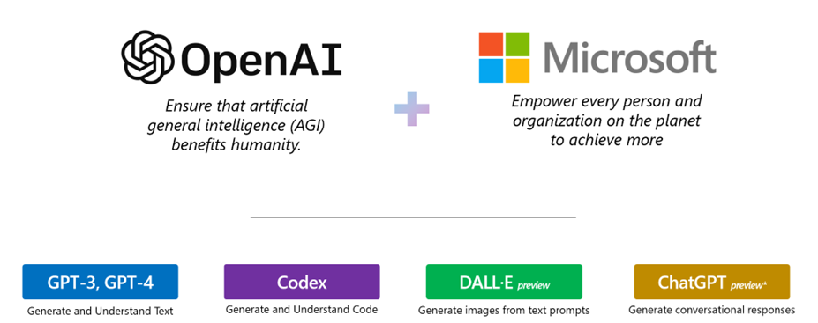

Slide 92
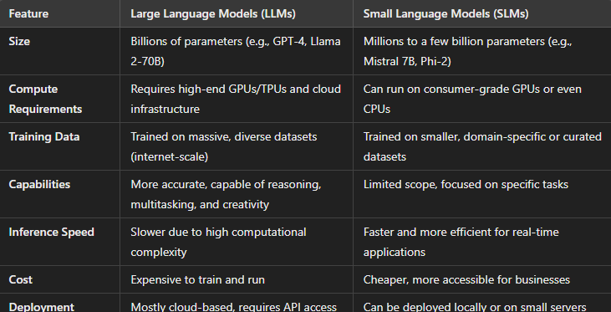

Slide 93
Copilot and AI agents
Generative AI apps provide contextual support with everyday tasks; typically using a language model to interpret and generate natural language.
Microsoft Copilot is a generative AI app that is integrated into a wide range of Microsoft applications and user experiences.
Business users can use generative AI to boost their productivity and creativity with AI-generated content and automation of tasks.
Developers can:
Extend Microsoft Copilot through integration with business processes and data.
Create copilot-like agents to incorporate generative AI capabilities into apps and services.

Slide 94
AI Hallucinations and Limitations
AI Hallucinations (False/Misleading AI Responses)
🔍 Causes:
Incomplete Data – AI fills gaps with guesses.
Pattern-Based Output – No true "understanding."
No Fact-Checking – Generates plausible but false info.
Examples:
Fake research papers or legal cases.
Incorrect historical/scientific facts.

Slide 95
AI Hallucinations and Limitations
Limitations of Generative AI
⚠ Challenges:
Knowledge Gaps – Outdated, biased, lacks reasoning.
Accuracy Issues – Inconsistent, misinterprets context.
Ethical Risks – Misinformation, privacy, deepfakes.
Legal Challenges – Copyright, regulatory concerns.
🛠 Mitigation: Fact-checking, human oversight, fine-tuning, responsible AI use.

Slide 96
The Core Components of a Copilot
User Experience: This is the entry point where users interact with the copilot through text, audio, or visual prompts. The user experience is crucial for making the interaction intuitive and effective.

Slide 97
The Core Components of a Copilot
Orchestrator: Acting as the central hub, the orchestrator plans and coordinates the system’s responses. It determines which parts of the system can best address the user’s needs

Slide 98
The Core Components of a Copilot
Foundational Model: Often an LLM, the foundational model serves as the AI’s reasoning engine. It analyzes information to answer questions or solve problems, drawing on vast amounts of data.
Contextual Understanding: The copilot uses contextual information to provide more accurate and relevant responses. This involves understanding the user’s intent and the context of their request.

Slide 99
additional elements to handle more complex tasks
Integration with Tools: Copilots are integrated with various productivity tools like Microsoft 365 apps, enabling seamless assistance across different tasks and applications.
Security and Compliance: Ensuring data security and compliance with regulations is a critical aspect of any AI system. Copilots are designed to operate within secure environments, protecting user data and maintaining privacy.

Slide 100
practical ways AI copilots can enhance productivity:
Providing Insights: By analyzing data, copilots can offer valuable insights and recommendations, helping users make informed decisions.
Enhancing Collaboration: Integrated with collaboration tools, copilots can facilitate better communication and teamwork, ensuring everyone stays on the same page.

Slide 101
Questions ????

